Slide 1

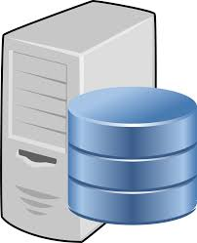


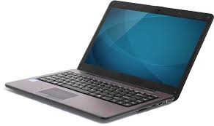


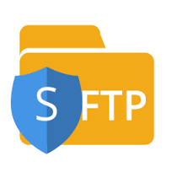
ENVIROMENT NOW
Report
AD
Log file
F13
Local PC
Yesfile
Log file
Yesfile
F13
WEB PC

Slide 2
Scenario 1
AD
Local Network
ADのApproved
が必要
Log file
Yesfile
F13
Log file
Yesfile
WEB PC
ADのApproved
が必要
F13
MPMJ
Report

Slide 3
Scenario 2
AD
Local Network
ADのApproved
が必要
Log file
Yesfile
F13
Log file
Log file
Yesfile
F13
Yesfile
F13
WEB PC
F13
ADのApproved
が必要
MPMJ
Report

Slide 4
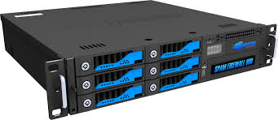
Scenario 3
AD
ADのApproved
が必要
Report
F13
Yesfile
Log file
WEB PC
All the Reports (IB, Shinkin, DAMs) At AD could be send automate

Slide 5



1
2
3
Batch Scripts
Using Win SCP
Upload Data
To our DB
SQL SERVER
DATA BASE MAIL

Slide 6
WinSCP What do it need?
1
Now only the Web Terminal can access the FTP server.
We need specify the server that you will access and give the grant for it.

Slide 7
Sql Scripts for upload the data to DB What do it need?
2
Specify the server that we will receive the information.

Slide 8
SQL Server – DataBase Email What do it need?
3
Configuration SQL Server For send email.
Enable SQLServerAGENT
Enable Service Broker
Enable email by SQL server
Configure data base mail
SMTP pattern

